Slide 1

Act Locally, Impact Globally

Slide 2
Lecture 5: Feature Selection -II

Slide 3
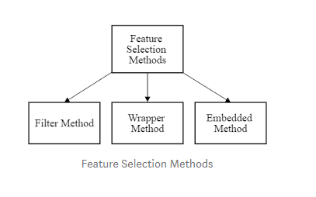
Feature Selection Methods

Slide 4
Filter Methods
Based on Statistical Tests
Chi Square Statistic ( Categorical – Categorical)
Correlation Coefficient ( Numerical – Numerical)
ANOVA ( Categorical – Numerical)
LDA ( Numerical – Categorical)

Slide 5
ANOVA
ANOVA – Analysis of Variance
Variance is the measurement of the spread between values in a variable. It measures how far a number is from the mean and every number in a variable.
The variance of a feature determines how much it is impacting the response variable.
If the variance is low, it implies there is no impact of this feature on response and vice-versa.

Slide 6
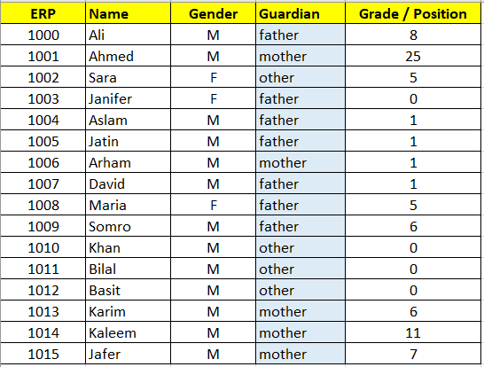
ANOVA – Example
Whether Guardian type has an impact on the grade ?
Whether the variance in grades is uniform across different categories / values of guardian
If all categories have same mean (grades) or not.

Slide 7
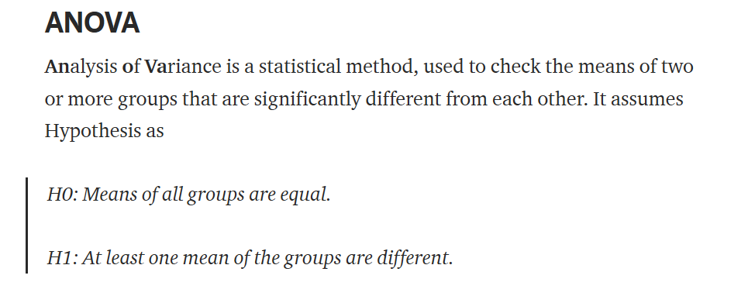
ANOVA – Analysis of Variance

Slide 8
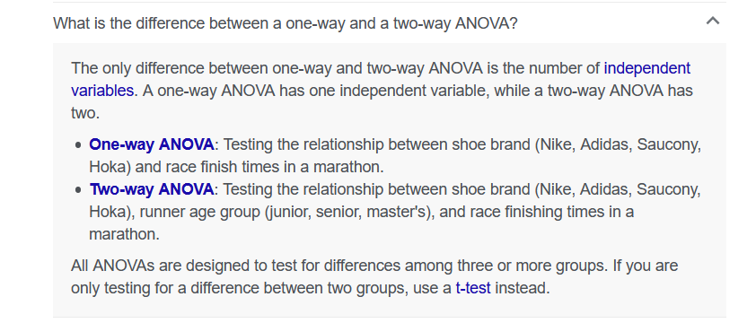
ANOVA TYPES

Slide 9
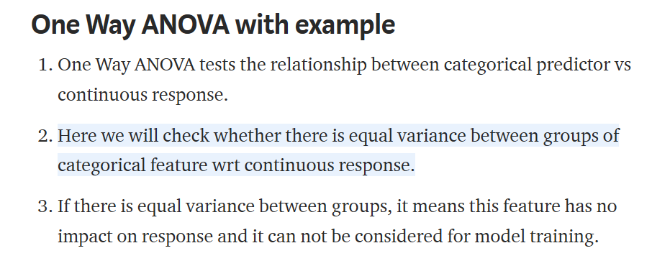
One-way ANOVA for Features Selection ( Categorical – Numerical)

Slide 10
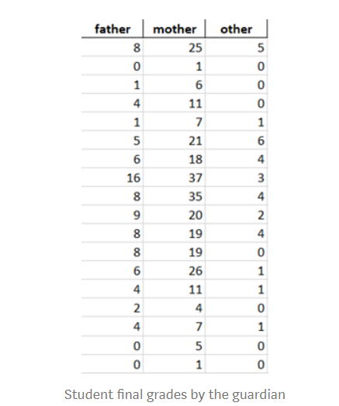
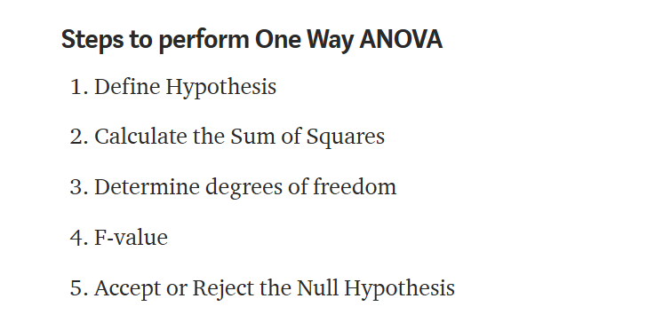
One-way ANOVA

Slide 11
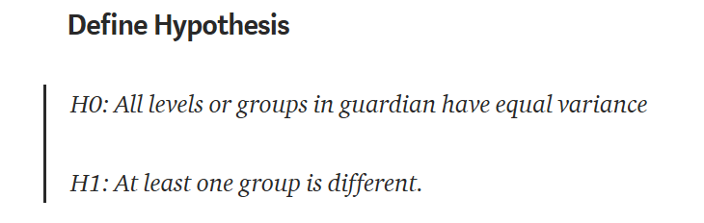
Example

Slide 12
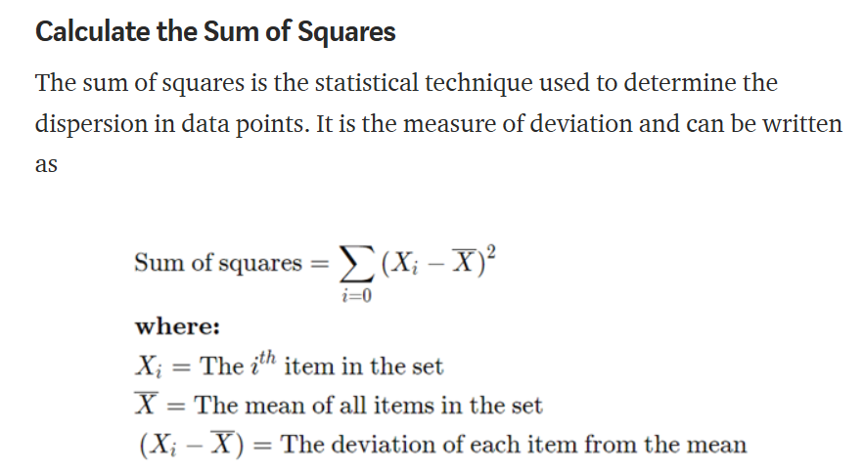
ANOVA – Example

Slide 13
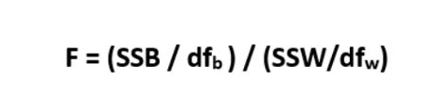
F-Statistic
In ANOVA we use F-Statistic to test the hypothesis which is given by:
SSB= Between Groups Sum of Squares
SSW= Within Groups Sum of Squares

Slide 14
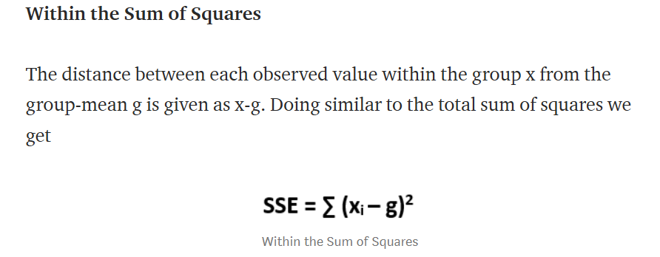
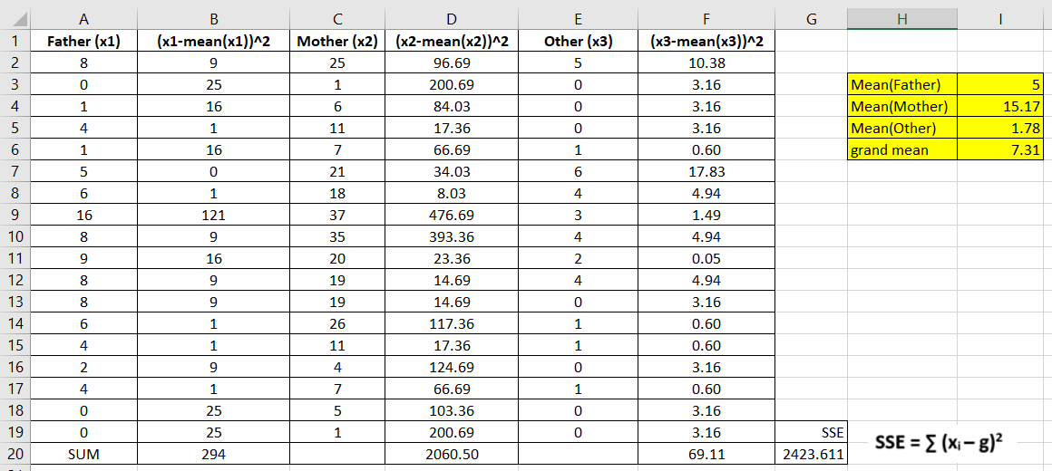
Within Group Sum of Squares

Slide 15
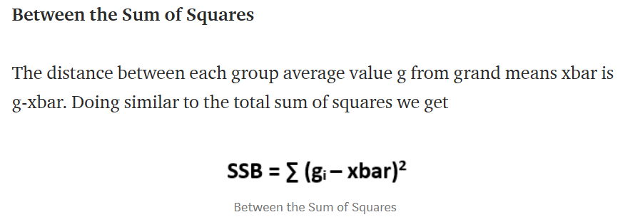
Between Group Sum of Squares(SSB)

Slide 16
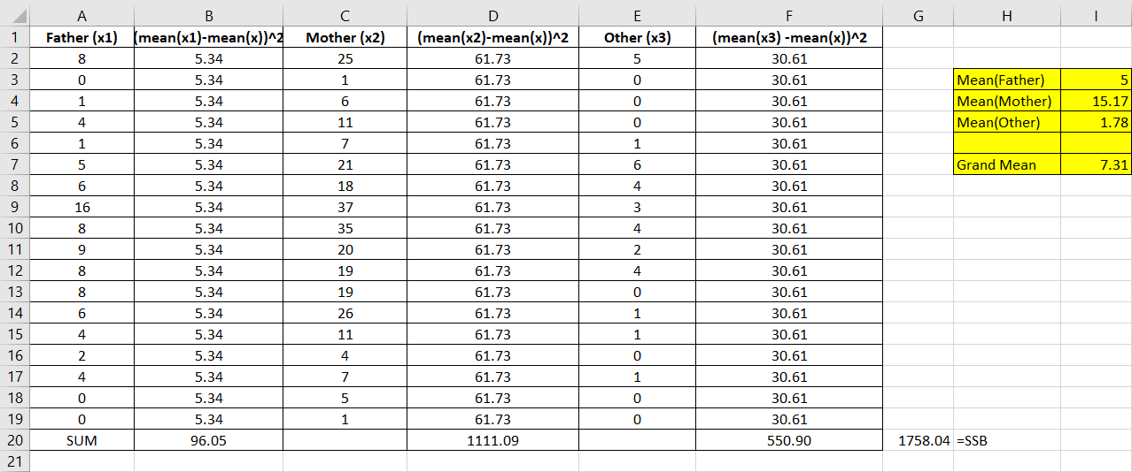
SSB

Slide 17
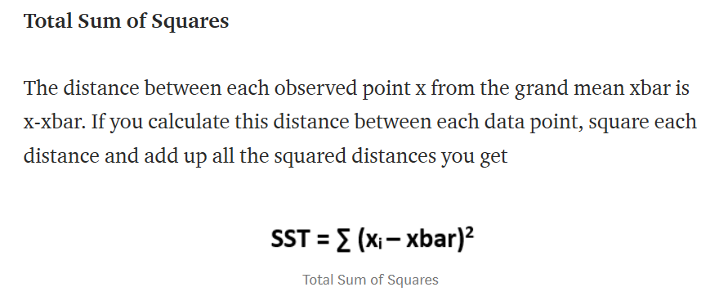
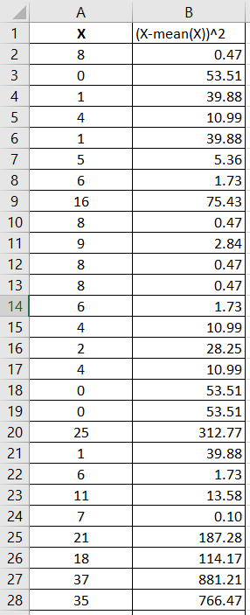
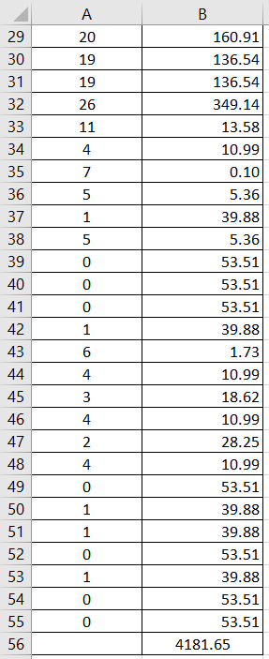
Total Sum of Squares

Slide 18
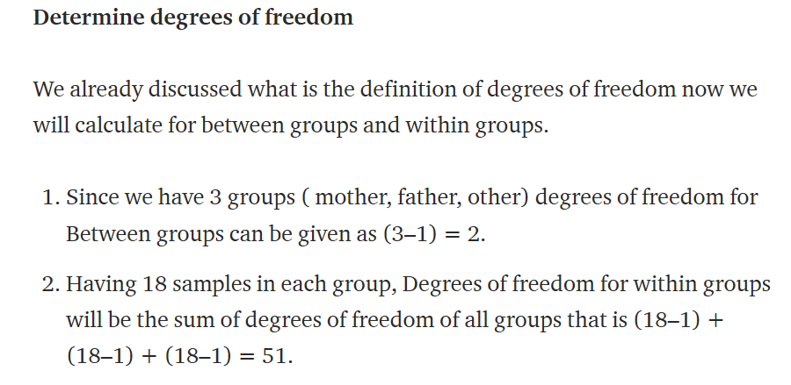
Degrees of Freedom

Slide 19
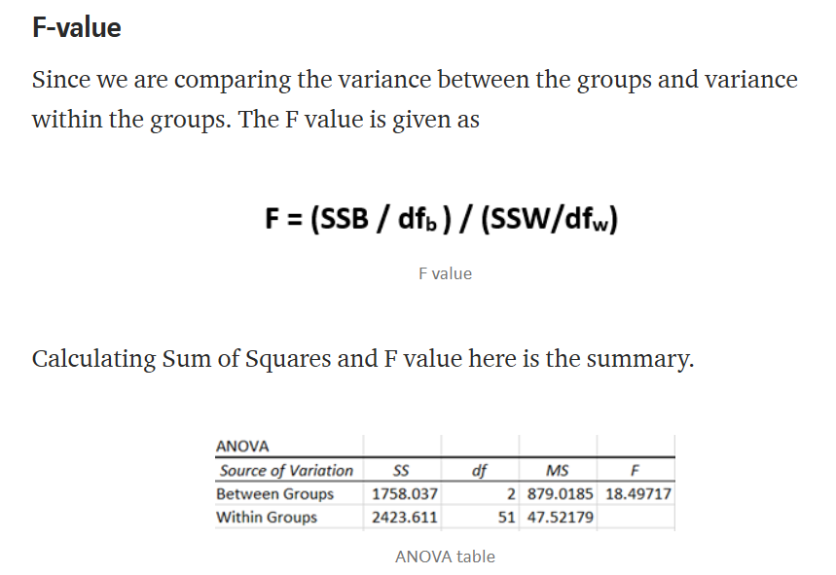
F-Value

Slide 20
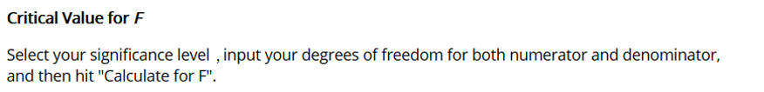
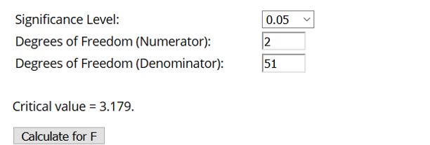
F Table

Slide 21
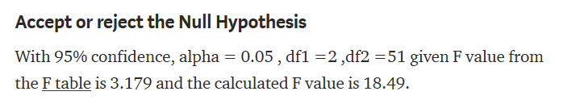
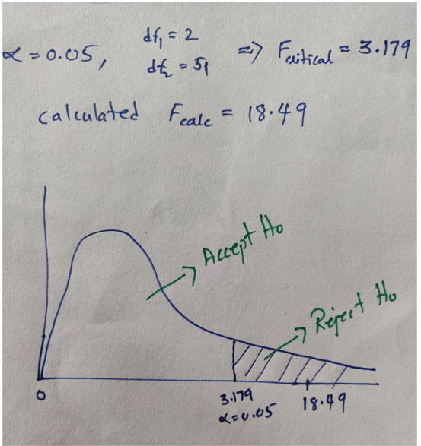
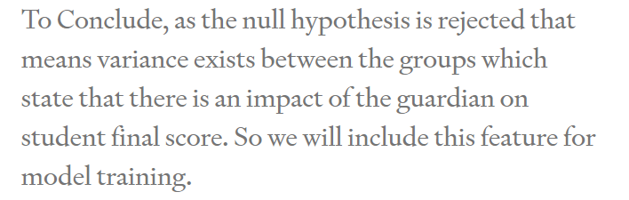
Decide

Slide 22
Dimension Reduction using LDA
https://towardsdatascience.com/linear-discriminant-analysis-in-python-76b8b17817c2

Slide 23
Feature Selection Methods

Slide 24
Wrapper Methods
In wrapper methods, we try to use a subset of features and train an ML model using them.
Based on the inference that we draw from the previous model, we decide to add or remove features from the subset.
The problem is essentially reduced to a search problem.
These methods are usually computationally very expensive

Slide 25
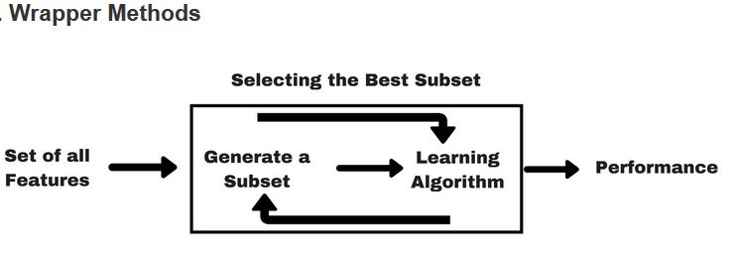
Wrapper Methods

Slide 26
Wrapper Methods
Some common examples of wrapper methods are :
Forward feature selection
Backward feature elimination
Recursive feature elimination, etc.

Slide 27
Forward Feature Selection
Forward Selection:
Forward selection is an iterative method in which we start with having no feature in the model.
In each iteration, we keep adding the feature which best improves our model till an addition of a new variable does not improve the performance of the model.

Slide 28
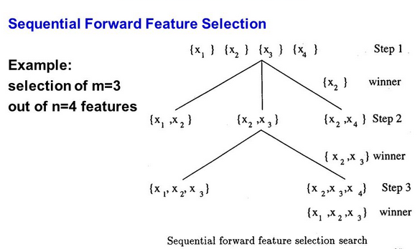
Sequential Forward Selection

Slide 29
Sequential Backward elimination
Backward Elimination:
In backward elimination, we start with all the features and remove the least significant feature at each iteration which improves the performance of the model.
We repeat this until no improvement is observed on removal of features.

Slide 30
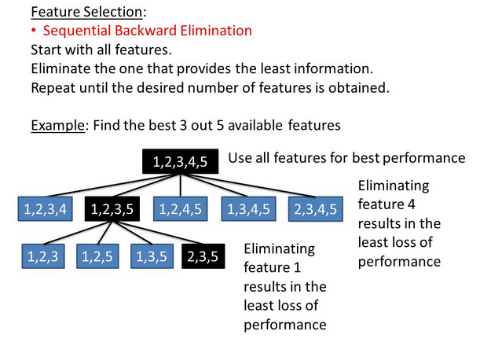
Sequential Backward Elimination

Slide 31
Recursive Feature Elimination
Recursive Feature elimination:
We need to specify the ML Algorithms as well as number of features to retain
RFE starts with all the features and builds a model and assigns ranks to all features based on model’s performance
RFE eliminates the lest important feature and rebuilds the model
The process continues till desired number of features have been removed.

Slide 32
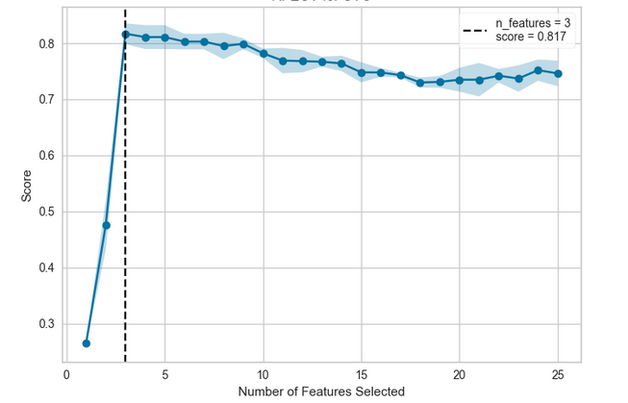
Recursive Feature Elimination

Slide 33
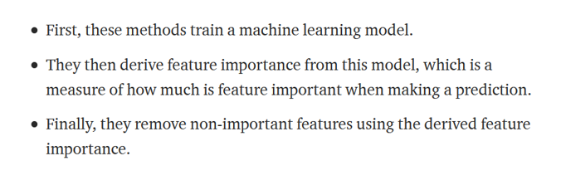
Embedded Methods

Slide 34



Embedded Methods
EMBEDDED METHODS COMBINE THE QUALITIES OF FILTER AND WRAPPER METHODS.
IT’S IMPLEMENTED BY ALGORITHMS THAT HAVE THEIR OWN BUILT-IN FEATURE SELECTION METHODS.
EXAMPLES ARE LASSO AND RIDGE REGRESSION AND RANDOM FOREST

Slide 35
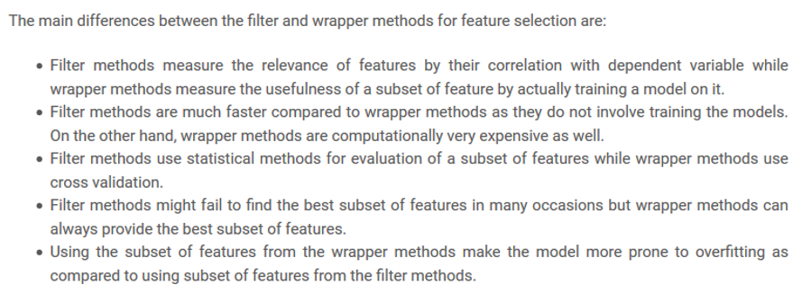
Filter Methods vs Wrapper Methods

Slide 36
Hands On :

Slide 37
Wrapper Methods for Feature Selection
One Way ANOVA for Feature Selection
Random Forest for Features Importance

